Slide 1


Heart Attack Risk Prediction: A Data-Driven Approach
This project analyzes patient data to predict heart attack likelihood. I'll explore various features, visualize patterns, and apply machine learning techniques for accurate risk assessment.
by Mahmoud Ezzat Saad Allah

Slide 2
Importing Libraries
Essential libraries like pandas , seaborn, matplotlib, and scikit-learn are imported. These tools enable data manipulation, visualization, and model building.

Slide 3
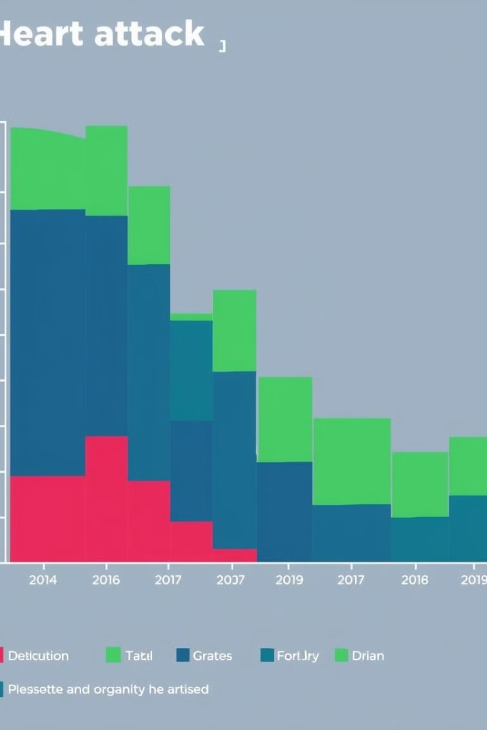
Loading and Exploring the Data
Load the heart attack dataset using pandas. Explore data distributions and relationships using visualizations.

Slide 4
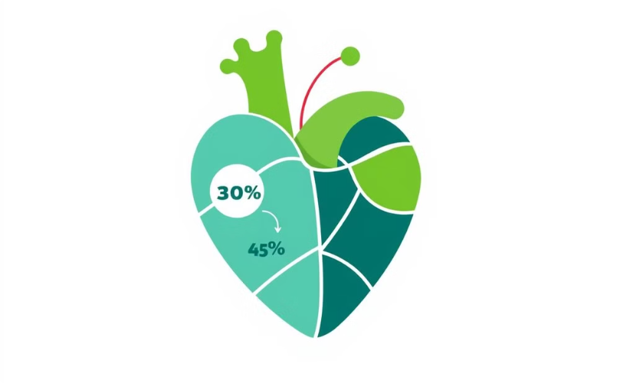
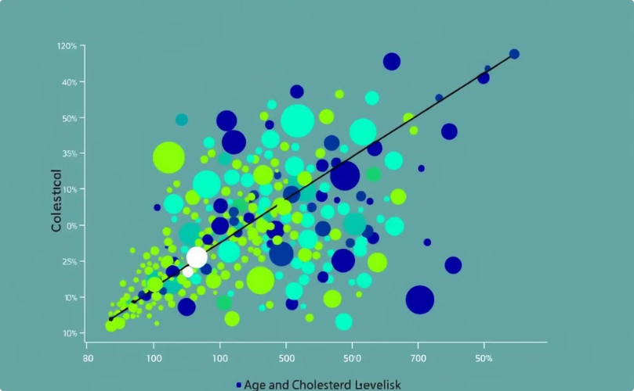
Data Visualization
Target Variable Distribution
Correlation Exploration
Visualize heart attack risk distribution using a countplot.
Scatter plots explore relationships between age, cholesterol, and risk.

Slide 5

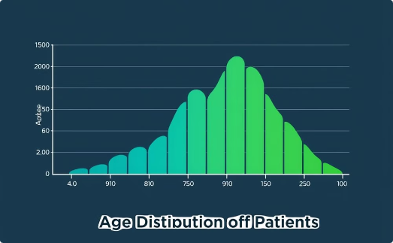
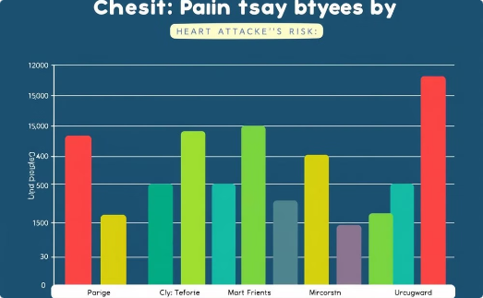
Data Visualization (Continued)
Countplot
Histogram
Bar Plot
Visualizes the distribution of heart attack risk categories among patients. Reveals imbalances in the dataset.
Shows age distribution of patients. Identifies age groups with higher heart attack risks.
Shows chest pain types by risk and reveals categorical variable insights

Slide 6
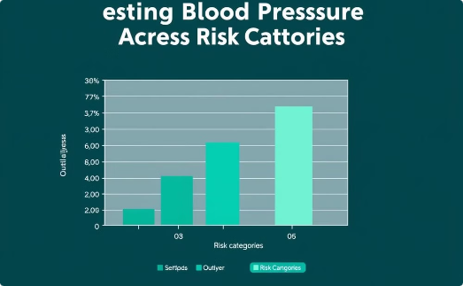
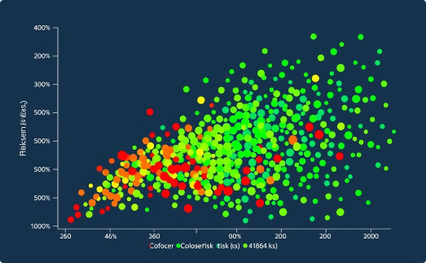
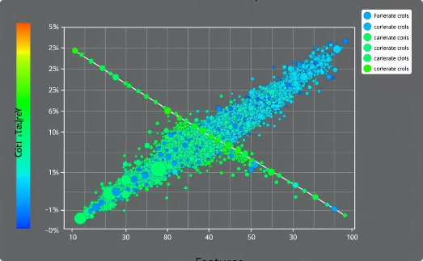
Data Visualization (Continued)
R
Box Plot
Scatter Plot
Heatmap
Compares resting blood pressure across risk categories. Identifies outliers and distribution differences.
Examines age vs. cholesterol relationship. Color-coded by risk, revealing potential correlations.
Displays feature correlations and highlights strongest predictors of heart attack risk.

Slide 7

Data Preprocessing
1
Standardization ( Scaling )
Scales numerical features using StandardScaler(). Ensures mean of 0 and standard deviation of 1.
2
One-hot Encoding
Converts categorical variables to binary features. Uses pd.get_dummies() for model compatibility.
3
Train-Test Split
Divides dataset into 80% training and 20% testing sets. Ensures unbiased model evaluation.

Slide 8




Model Training: Logistic Regression
Model Selection
Logistic Regression chosen for binary classification. Predicts likelihood of heart attacks.
Training
Model fitted on training data. Learns patterns and relationships between features and target.
Prediction
Trained model makes predictions on test set. Classifies patients into risk categories.

Slide 9
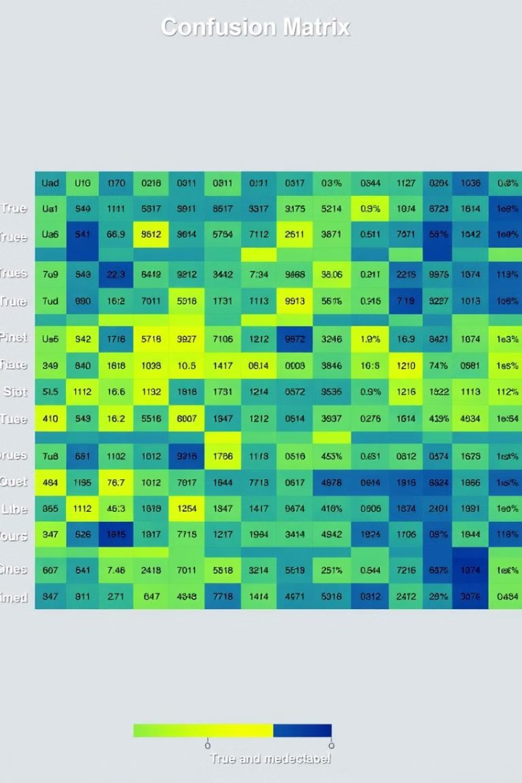
Model Evaluation Metrics
Metric
Description
Importance
Accuracy
Percentage of correct predictions
Overall model performance
Precision
True positives / (True positives + False positives)
Minimizes false alarms
Recall
True positives / (True positives + False negatives)
Minimizes missed cases
F1-score
Harmonic mean of precision and recall
Balanced metric for imbalanced data

Slide 10

Hyperparameter Tuning
1
GridSearchCV
Systematically tests combinations of hyperparameters. Finds optimal regularization strength and penalty type.
2
Cross-Validation
Uses k-fold cross-validation. Ensures robust performance across different data subsets.
3
Best Parameters
Identifies most effective hyperparameter combination. Improves model accuracy and generalization.

Slide 11




Project Insights and Future Directions
Key Findings
Identified strongest predictors of heart attack risk. Age and cholesterol showed significant correlation.
Model Performance
Achieved 86.89% accuracy after tuning. Demonstrates potential for clinical decision support.
Future Work
Explore advanced models like Random Forests. Incorporate more diverse patient data for improved predictions.

Slide 12

Thank You

